Slide 1

AWS BUILDING BLOCKS
By Faisal

Slide 2


Beginning Amazon Web Services
Chapters
Provisioning cloud resources
Building blocks - Network
Building blocks - Compute
Building blocks - Storage

Slide 3

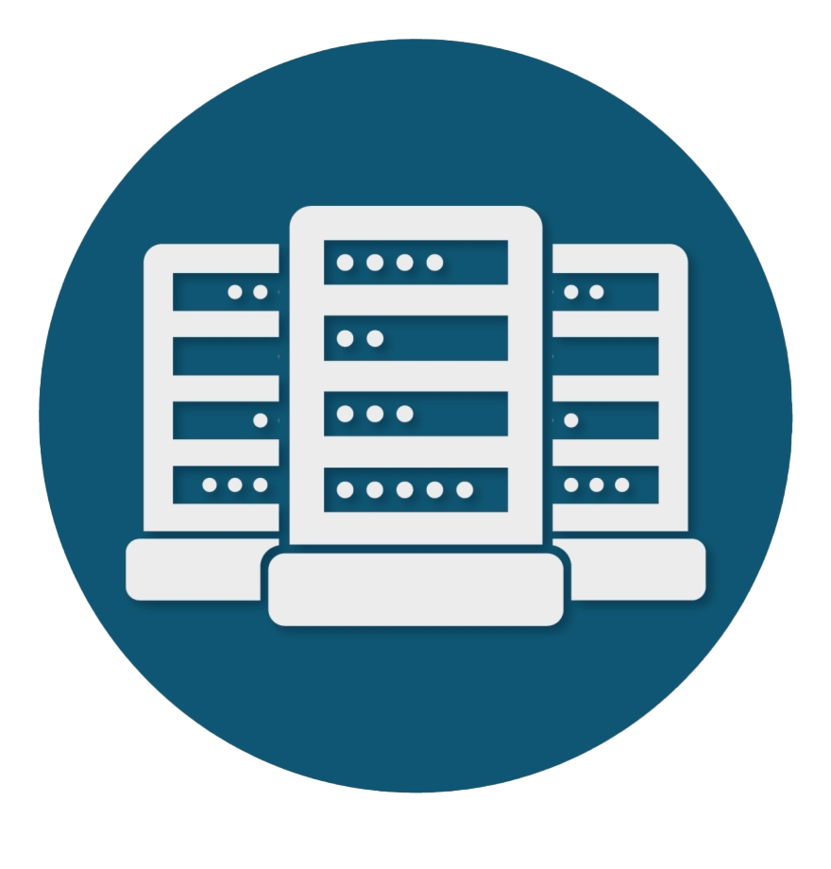
Beginning Amazon Web Services
Provisioning cloud resources
Regions and Availability Zones
One Availability Zone (AZ) is a set of data centers
Notes:
AZ = one or more DC in separate facilites with reduant power, network
Region is group of AZ connected with low latency
Talk about DR and HA
IAM = Who can Access, What
AZs are physically separated by a meaningful distance from other AZs in the same AWS Region, although they all are within 60 miles (100 kilometers) of each other. This generally produces single digit millisecond roundtrip latency between AZs in the same Region

Slide 4
Beginning Amazon Web Services
Provisioning cloud resources
Regions and Availability Zones
AZ 2
AZ 1
AZ
AZ 3
Within 100 km
Single digit latency
Notes:
AZ = one or more DC in separate facilites with reduant power, network
Region is group of AZ connected with low latency
Talk about DR and HA
IAM = Who can Access, What
AZs are physically separated by a meaningful distance from other AZs in the same AWS Region, although they all are within 60 miles (100 kilometers) of each other. This generally produces single digit millisecond roundtrip latency between AZs in the same Region

Slide 5
Beginning Amazon Web Services
Provisioning cloud resources
Regions and Availability Zones
Account and Security
API
Notes:
AZ = one or more DC in separate facilites with reduant power, network
Region is group of AZ connected with low latency
Talk about DR and HA
IAM = Who can Access, What
AZs are physically separated by a meaningful distance from other AZs in the same AWS Region, although they all are within 60 miles (100 kilometers) of each other. This generally produces single digit millisecond roundtrip latency between AZs in the same Region

Slide 6
Beginning Amazon Web Services
Building blocks - Network
Amazon VPC
Subnets
Internet Gateway
Notes:
VPC
AZ
Subnets
Internet Gateway

Slide 7
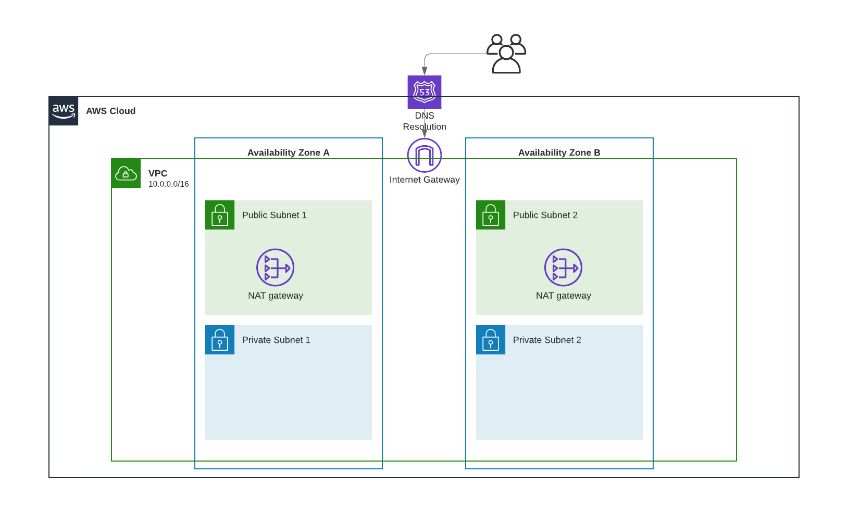
Beginning Amazon Web Services

Slide 8
Beginning Amazon Web Services
Building blocks - Compute
Amazon EC2
Autoscaling
Amazon Elastic Load Balancer
Notes:
SSH, cloud shell, linux, windows, Graviton, Nitro

Slide 9
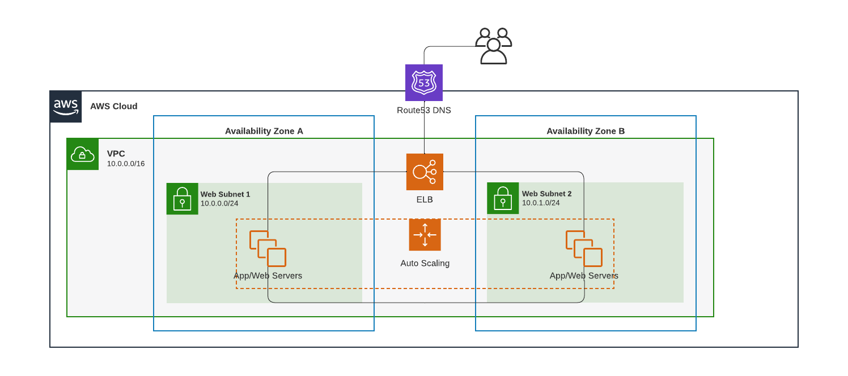
Beginning Amazon Web Services

Slide 10
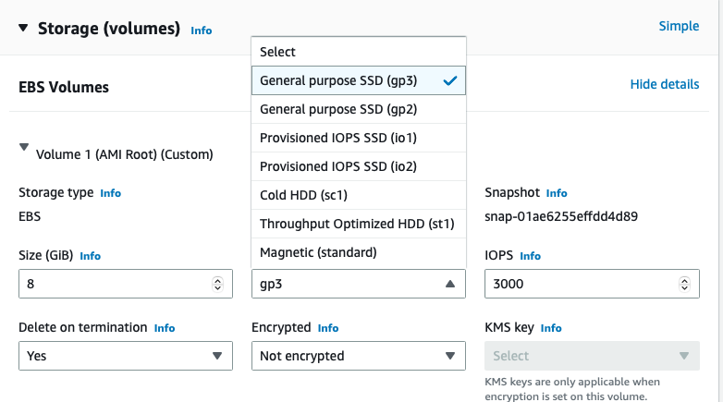
Beginning Amazon Web Services
Building blocks - Storage
Amazon EBS

Slide 11
Beginning Amazon Web Services
Building blocks - Storage
Amazon EBS
Amazon S3
Amazon EFS
Notes:
S3 – Object storage
EFS - Create and configure shared file systems simply and quickly for AWS compute services—no provisioning, deploying, patching, or maintenance required.

Slide 12

Beginning Amazon Web Services
Summary
Provisioning and Security
Basic building blocks
Next Steps
Notes:
Talk about how easy is to start. Just logni to aws console and start trying…

